Slide 1
Acoustics Ultrasound Imaging 2015
Ultrasound Imaging 2015

Slide 2
Ahmed Elnokrashy
Mail:
a_nokrashy@link.net
Course FTP:
www.piazza.com Available on mobile
course name: Acoustics and Ultrasound
course number: E1301
Access code: e1301
sign up using full name and ID
Password: bme
Lecture, References, Materials, Assignments
Ultrasound Imaging 2015

Slide 3
Ultrasound Imaging
Instructor
Instructor

Slide 4
Ultrasound Imaging
Manufacturing
Research & development
Management
Academic
Courses
H/W design
Medical Power Supply
Embedded system
S/W design
Parallel computing
Visualization
H/W: Ultrasound,2D,3D,4D,PW
Doppler, color Doppler
S/W: Dyalisys,3D,4D
US, US Doppler, ICU Monitor, Dialysis, Embedded system, Visualization, Speckle R
Instructor

Slide 5
Ultrasound Imaging
Expectations and wishes?
Expectation

Slide 7
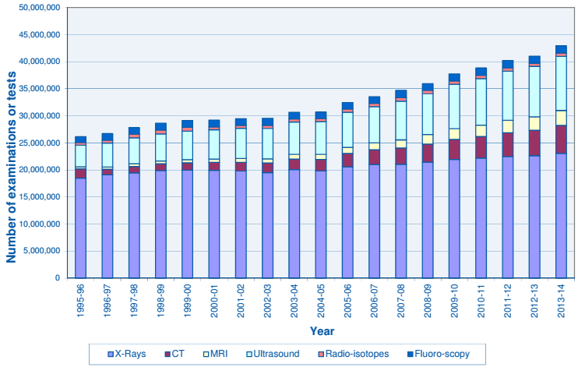

Slide 8
Ultrasound Imaging
Course objective
objective

Slide 9
Ultrasound Imaging
Biomedical Engineers
Sales & Marketing
Nonrelated Software
Maintenance & support
Research & development
Course objective

Slide 10
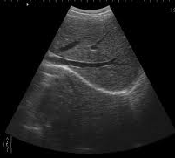
Ultrasound Imaging
Technology/Instrumentation
Physics
Imaging
Course objective

Slide 11
Ultrasound Imaging
Rules
- Questions
I Can’t understand? (who is responsible?)
Why we study these things?
Rules

Slide 12
Ultrasound Imaging
Rules
- Discussion
Most lectures will be based on discussions
Rules

Slide 13
Ultrasound Imaging
Rules
- Attendance
So important as there is no one material can cover the course content
Rules

Slide 15
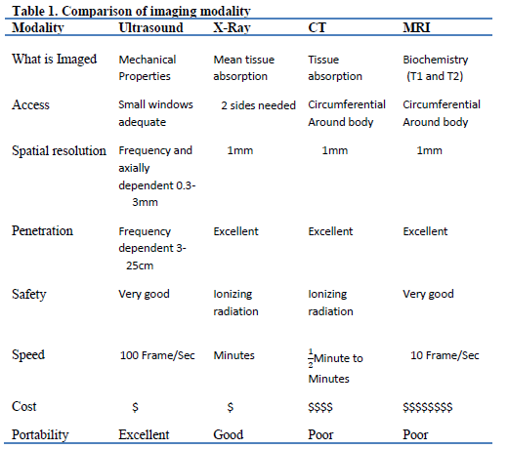

Slide 16
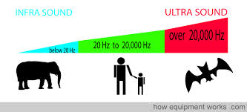
Ultrasound

Slide 17
Ultrasound Frequency range

Slide 18
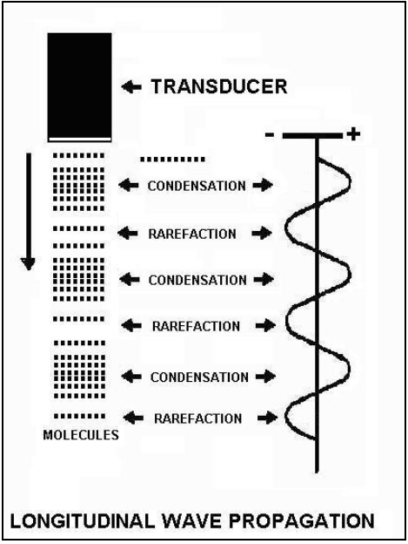
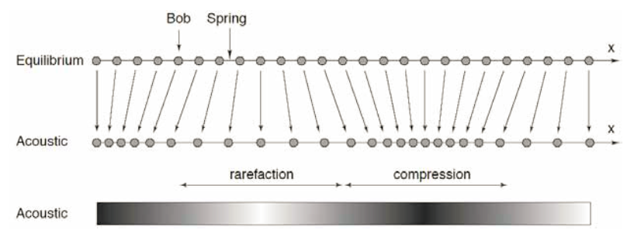
Ultrasound wave type

Slide 19
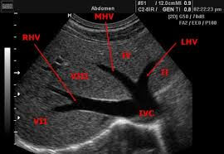
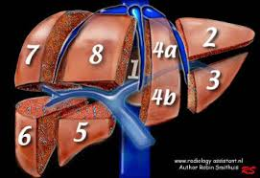
Ultrasound image (liver)

Slide 20
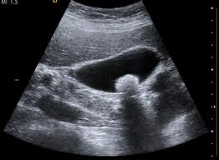
Ultrasound image (Gallbladder stone)

Slide 21
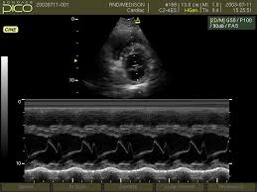
Ultrasound image (M-mode)

Slide 22
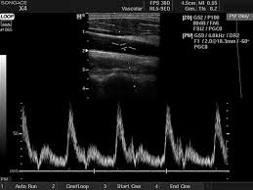
Ultrasound image (PW Doppler)

Slide 23
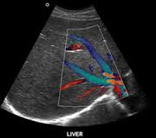
Ultrasound image (Color Doppler)

Slide 24
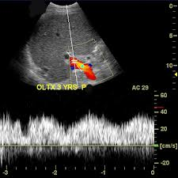
Ultrasound image (Doplex/Triplex)

Slide 25
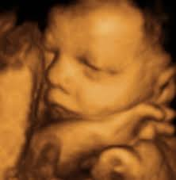
Ultrasound image (fetal 3D)

Slide 26
Ultrasound image (fetal 4D)
D:\Projects\PHD\Thesis PHD\Seminar\Presentaion

Slide 27
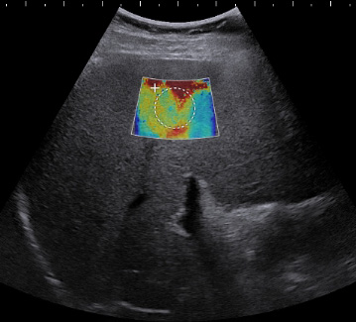
Ultrasound image (elastography)

